Slide 1
Health Insurance Access and the Impact on Cancer Outcomes
Thursday, July 8, 2021, 10:00-11:00
Notes:
Thank you for joining today's webinar on Health Insurance Access and the Impact on Cancer Outcomes. This call is being recorded. ​ If you are experiencing technical difficulty, please use the chat for assistance or the help options within Zoom.

Slide 2
Who We Are
Wisconsin Cancer Plan
2020-2030
The Wisconsin Cancer Collaborative is a statewide coalition of 140 organizations working together to reduce the burden of cancer for everyone in Wisconsin.
Join Us!
www.wicancer.org/join/
www.wicancer.org
Notes:
Before we get started today, I have just a few housekeeping items to go over. Firstly, we are delighted to have so many new people join us today, along with our existing members. ​
For those of you who may not be as familiar, we are the Wisconsin Cancer Collaborative: Wisconsin's statewide comprehensive cancer coalition comprised of 140 organizations working together to reduce the burden of cancer for everyone in Wisconsin. ​If you are not yet a member, we’d love to have you join, membership is free! If you are interested in join, you can do so at the link on the screen.

Slide 3
It's time to renew your membership with the Wisconsin Cancer Collaborative!
Every two years, we ask our members to renew their membership with the Wisconsin Cancer Collaborative, by reviewing and updating their Member Profile. This keeps your membership active, helps us improve our outreach and evaluation efforts, and helps our members network and connect with partners.
This year, we are asking ALL members -- regardless of when you joined -- to review your Member Profile and add three new items:
Your Wisconsin Cancer Plan priorities
The counties you serve
The populations you serve
View detailed instructions here: www.wicancer.org/2021renewal/
Notes:
And secondly, for those who are members, it’s membership renewal time!
Yesterday an email went out with instructions on how to renew your membership. It’s easy and quick to do! This year we are asking all members to add a few new pieces of information to your profile including WICP priorities, counties your serve, and the populations your serve. If you have any questions, feel free to send us a message!

Slide 4
Agenda
Welcome
Intro
Presentation by Courtney Harris
Questions
www.wicancer.org

Slide 5
Courtney Harris, MSW Outreach & Partner Development Manager Covering Wisconsin
Notes:
Courtney joined the Covering Wisconsin team in 2021. She supports Covering Wisconsin’s current outreach work and identifies and develops new opportunities to reach consumers throughout the state, with a special focus on serving communities most at-risk for lack of coverage and access to care. This includes building and strengthening relationships with partner organizations and community leaders, and identifying mutually beneficial opportunities for partnership. Courtney comes to Covering Wisconsin with a background in social work and experience in program management, stakeholder engagement, and health and public benefits policy. She holds a Master’s of Social Work from UW-Madison and a Bachelor’s of Science in Psychology from UT-Austin.

Slide 6
Partnering to Increase Access to Health Insurance Coverage
Wisconsin Cancer Collaborative
July 8, 2021
Notes:
“We know from a great deal of research on financial toxicity and cancer outcomes that insurance coverage is necessary for screenings and early detection, cancer treatments and care, and the ongoing needs of survivors.”

Slide 7
Introduction
Courtney Harris
Outreach & Partner Development Manager
Covering Wisconsin

Slide 8
Agenda
Intro to Covering Wisconsin & free enrollment help
Brief overview of:
Health insurance options in Wisconsin
American Rescue Plan (COVID relief law) impacts
Resources from Covering Wisconsin & partners
Opportunities for Partnership with Cancer Prevention & Control Partners
Questions

Slide 9
Covering Wisconsin
Covering Wisconsin is a nonprofit that helps people in Wisconsin find and use health insurance.
CWI develops materials and trains on health insurance topics.
Our expert Navigators provide free help with health insurance.
www.CoveringWI.org

Slide 10
Covering Wisconsin Health Insurance Navigators
Talk to a Navigator to:
Find plans and financial help.
Sign up for HealthCare.gov, BadgerCare Plus or Medicaid.
Get answers to your health insurance questions. No question is too big or too small.
Get help with billing or coverage problems, including appeals.
Notes:
Additional charity care and other programs and supports to cover cancer treatment and control costs

Slide 11
Referring to an Enrollment Assister
Two ways to make an appointment:
1. Call
Covering Wisconsin at (608) 261-1455 or (414) 400-9489
Local enrollment assister
2-1-1
2. Wisconsin Health Insurance Connector Tool, www.coveringwi.org/enroll

Slide 12
Health Insurance Options in Wisconsin
BadgerCare Plus
(State of Wisconsin Medicaid)
Low-cost or free comprehensive health coverage, provided by the State of Wisconsin
Healthcare.gov
(Federal Health Insurance Marketplace)
Financial help based on income
Enroll now until August 15th
Enroll for 2022: Nov 1-Dec 15
(proposed extension to Jan 15)
Notes:
Two primary options for publicly available health insurance in Wisconsin (under 65):
BadgerCare Plus – Medicaid, health insurance that is a public benefit for people with lower income. Also referred to as BadgerCare, Medical Assistance, MA, State insurance, or by the ForwardHealth card.
Marketplace – Federal health insurance Marketplace. Also referred to as Obamacare, Affordable Care Act, ACA, or Healthcare.gov.

Slide 13
BadgerCare Plus (Medicaid)
Low-cost or free comprehensive health coverage, provided by the State of Wisconsin
Since March 2020, anyone who has been enrolled in BadgerCare Plus has remained continuously eligible (not kicked off the program) – this will continue for the duration of the Public Health Emergency (PHE)
Notes:
COURTNEY

Slide 14
Health Insurance Marketplace
Almost everyone can get a Marketplace plan, but financial help is based on income
Standard Open Enrollment Period is November 1 – December 15
This year, Healthcare.gov has re-opened from February 15 – August 15
Notes:
COURTNEY
Financial help is based on income. If you can get affordable insurance from a job, you will NOT get financial help for a Marketplace plan. Healthcare.gov calculates all of this, and enrollment assisters will help.
(if asked: someone can choose if they want to get the tax credit all at once when they file taxes, or split across each month)

Slide 15
Other Health Insurance Options
Health Insurance from a Job
Medicare
Contact an Aging and Disability Resource Center (Find an ADRC)
COBRA
New help paying for COBRA premiums in American Rescue Plan
Other Options – through spouse’s insurance, staying on parents’ insurance until age 26
Short-term limited-duration health plans, fixed benefit plans, VA health care, and other non-insurance options
Notes:
Contact enrollment assisters with any question - a referral might still make sense: i.e. on COBRA, covered but paying too much, not enrolled for fear of immigration, etc.;
ADRC referrals for Medicare, us for everything else. Enrollment assisters can help people figure out what their options are.

Slide 16
American Rescue Plan Act (COVID Relief Law)
New COVID-19 relief makes Healthcare.gov prices lower than ever before
Increased financial help (lower premiums) for all income groups
$0 monthly plans for people up to 150% of the federal poverty level (FPL), or $32,580 for a family of 3
New premium tax credits for people with incomes above 400% FPL ($86,880 for a family of 3) – no one will pay more than 8.5% of their income
Extra financial help for people who are unemployed in 2021 as of July 1
We encourage consumers to look again!

Slide 17
American Rescue Plan Act (COVID Relief Law)
Also included in the law:
Free COBRA coverage for a limited-time for people who have been laid-off or had job hours reduced
Health coverage-related tax relief for 2020 tax year
New Medicaid state options – including extending postpartum Medicaid coverage & extra incentives to expand Medicaid

Slide 18
Increases APTCs across income levels for 2021 and 2022
Premiums reduced for all income levels and capped at 8.5% of FPL
Household Income (% of the FPL) | Current Law | American Rescue Plan Act
100 – 138% | 2.07% | 0%
138% - 150% | 3.1% - 4.14% | 0%
150% - 200% | 4.14% - 6.52% | 0% - 2.0%
200% - 250% | 6.52% - 8.33% | 2.0% - 4.0%
250% - 300% | 8.33% - 9.83% | 4.0% - 6.0%
300% - 400% | 9.83% | 6.0% 8.5%
400% + | N/A | 8.5%
Adapted from: Impact of Key Provisions of the House COVID-19 Relief Proposal on Premiums (KFF). See also: Health Insurance Marketplace Calculator (KFF)

Slide 19
Expands financial help for people receiving unemployment
Anyone receiving unemployment at any point in 2021 will have their income capped at 133% FPL for purposes of determining Marketplace financial help
All non-smoking* consumers receiving unemployment will be eligible for a $0 benchmark (silver) plan with cost-sharing reductions (CSRs)
Note: This change was just implemented July 1
*Plans can still charge a tobacco surcharge that would still apply

Slide 20
ARPA: Consumers Should Update Healthcare.gov Account
If a consumer is already enrolled in a Marketplace plan, should they return to the Marketplace to review new plans?
Yes. All enrollees should log in to Healthcare.gov or call the Marketplace to update their application and review plan options before August 15. They may find plans with lower premiums or lower out-of-pocket costs for the same price or less than they are currently paying.

Slide 21
COVID-Relief/ARPA: Changing Plans
Will the out-of-pocket costs a consumer has already paid for 2021 carry over towards the deductible/OOP max of a new plan?
It depends. A consumer switching health plans should expect to start paying toward new deductibles and new out-of-pocket maximums. If a consumer stays with the same insurer, they should talk to the company to see if they can carry over their previous payments. In most cases, they can—even if switching to Healthcare.gov from an off-Marketplace plan.

Slide 22
Provides free COBRA coverage through September 2021
Subsidize entire COBRA premium until September 2021 for laid-off workers (via tax credit to employers/plans)
Extends enrollment window to allow any employee still within their COBRA eligibility period (usually 18-36 months) to enroll
Employers were required to notify employees by June 1
People who voluntarily leave work or are eligible for Medicare or other group coverage are not eligible

Slide 23
COVID-Relief/ARPA: COBRA
Will people who choose to enroll in free COBRA be eligible for a Marketplace special enrollment period after the subsidy ends?
Yes. Consumers will be eligible for a special enrollment period to choose a Healthcare.gov plan when these COBRA savings end. However, costs consumers have already paid toward deductibles and other cost sharing will not carryover if they switch to a Healthcare.gov plan at this time.

Slide 24
Key Messages
Now is the time! HealthCare.gov is open again. You can sign-up if you’re not already covered or change your current plan.
Prices have dropped! Thanks to new COVID relief, 4 out of 5 people can find plans for $10 or less per month. Many more people can find $0 monthly plans.
Look again! Thanks to new COVID relief, more people than ever can get help paying for health insurance on Healthcare.gov, even people who did not qualify before.
Get free help finding the best plan for your health and budget. Call 2-1-1 or go to WisCovered.com to find free, expert help.

Slide 25
Key Messages
Already have a plan on Healthcare.gov? Go back to Healthcare.gov to get new savings or find a better plan for less.
Find a plan for right now. If you lost your job or had your hours cut, you can find a plan and financial help on Healthcare.gov and keep it for as long as you need it.
Spread the word! New COVID relief makes health insurance prices lower than ever before. Call 2-1-1 to find free, expert help, or visit WisCovered.com to learn more.

Slide 26
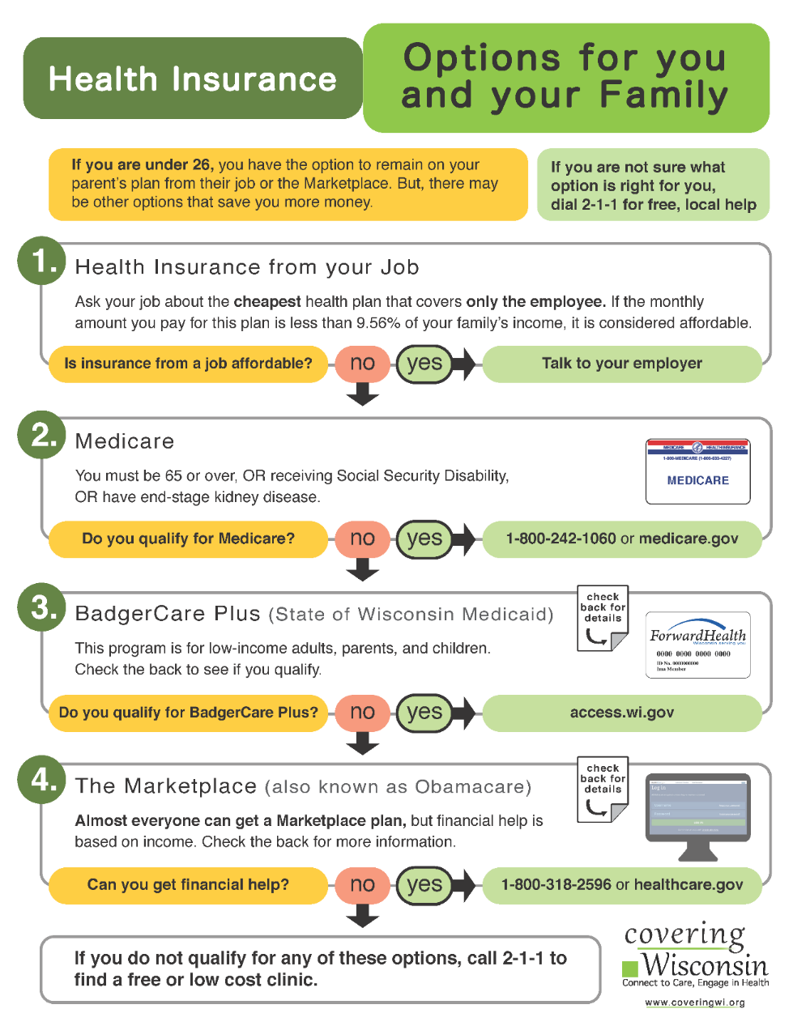
Covering Wisconsin Educational Resources
How-to Sheets
Coveringwi.org/learn
English and Spanish
ARPA Fact Sheet
English – Color or B&W
Spanish – Color or B&W

Slide 27
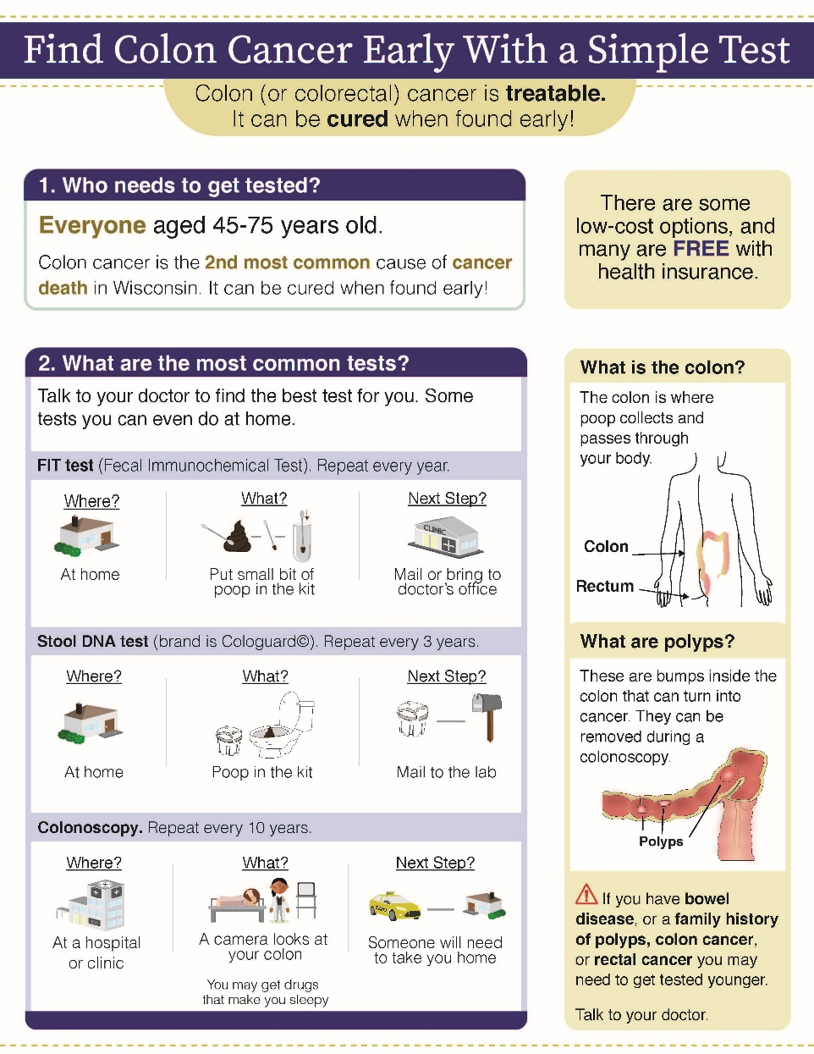
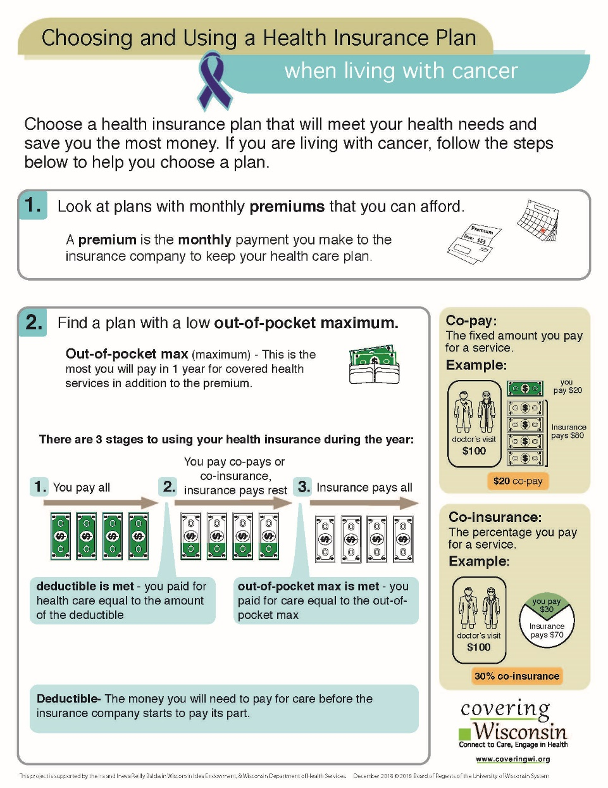
CWI & WCC How-To Sheets
WCC How-to Sheets
https://wicancer.org/resources/how-to-sheets/
English and Spanish
CWI & WCC Cancer How-to Sheet
English Only
Notes:
Do also have a Chronic Conditions version – that is in English and Spanish – posted on our how-to sheet page as well

Slide 28
Outreach and Promotional Materials
Covering Wisconsin:
Coveringwi.org/toolkit
English, Spanish
Download social media graphics, outreach cards, or flyers for printing – contact us to personalize!
Notes:
Do a walk-through of the toolkit, how to use the materials, and to contact me for co-branding/tailoring.

Slide 29
Outreach and Promotional Materials
OCI (Wisconsin Office of the Commissioner of Insurance):
Wiscovered.com/media-toolkit
Hmong, Spanish, English

Slide 30
Outreach and Promotional Materials: Social Media
Covering Wisconsin
Facebook
Twitter
Wisconsin Office of the Commissioner of Insurance
Facebook
Twitter
HealthCare.gov
Facebook
Twitter
CuidadoDeSalud.gov
Facebook
Twitter
Notes:
Follow and Share Covering Wisconsin on Facebook and Twitter – also partners, who post other things as well, but are good places to follow and re-share

Slide 31
Opportunities for Partnership with Cancer Control
Cancer Prevention and Control Partners:
Are trusted sources of information for consumers & other professionals
Can help connect more consumers to free, local enrollment help
Have key insights and experience – you can make this information most relevant to your audience
Are important partners in co-creating and tailoring materials
Help to inform policymakers on key issues
Notes:
WCC may chime in here
“We know from a great deal of research on financial toxicity and cancer outcomes that insurance coverage is necessary for screenings and early detection, cancer treatments and care, and the ongoing needs of survivors.”

Slide 32
Opportunities for Partnership with Cancer Control
Covering Wisconsin can provide:
Free, local help from Navigators
Free promotional materials and other resources to help you spread the word
Consumer-tested how-to sheets on key health insurance topics – including those focused on cancer prevention and control!
Trainings for professionals and educational sessions for consumers
Notes:
Including charity care and programs to help pay for treatment, etc.
Find plans and financial help.
Sign up for HealthCare.gov, BadgerCare Plus or Medicaid.
Get answers to your health insurance questions. No question is too big or too small.
Get help with billing or coverage problems (appeals).

Slide 33
Referring to an Enrollment Assister
Two ways to make an appointment:
1. Call
Covering Wisconsin at (608) 261-1455 or (414) 400-9489
Local enrollment assister
2-1-1
2. Wisconsin Health Insurance Connector Tool, www.coveringwi.org/enroll

Slide 34
Questions
Contact Covering Wisconsin
608-261-1455
www.coveringwi.org
Contact Courtney (charris2@wisc.edu)
Check out CWI’s ARPA Policy Summary

Slide 35
Questions? Comments?
Please take our poll! Will pop up on your screens shortly.
Stay tuned for resources you can use!

Slide 36
Resources – How to Sheets
Our How-To Sheets offer straightforward answers to questions so that patients can make informed choices about their health.
Use these tools to start important conversations with patients, families, and community members who may have health literacy differences.
www.wicancer.org/resources/how-to-sheets.com

Slide 37
Save the date! – August Networking Webinar
“The Financial Toxicity of Cancer: Causes, Effects, and Potential Solutions”
Cancer is one of the most expensive medical conditions a person can experience.
Learn more about what contributes to financial toxicity; how it impacts patients, survivors, and families; and how we might reverse this troubling phenomenon.
August
12
10:00-11:00
Register here: https://wicancer.org/events/webinars/
Notes:
Alex add reminder

Slide 38
Thank you!
Thank you for joining!
Stay well!
Notes:
Alex

