Slide 1
Comprehensive Cancer Control: What does it mean here in Wisconsin?
WI Cancer Council
Regional Meetings
October 2016
Milwaukee Madison De Pere Eau Claire La Crosse

Slide 2
Comprehensive Cancer Control
A collaborative and strategic approach that brings partners together to combine, share, and coordinate resources to reduce the burden of cancer across the whole continuum from prevention through end of life.
Partners coming together to: Reduce cancer risk * Find cancer earlier
Improve cancer treatments * Reduce death and suffering from cancer * Improve survivors’ quality of life
Notes:
This slide you will find a definition of comprehensive cancer control. Comprehensive cancer control, often shortened to CCC, is a collaborative and strategic approach used by communities and their partners to combine, share, and coordinate resources to reduce the burden of cancer across the whole continuum from prevention through end of life.
I like to remember is easier as “Partners coming together to: Reduce cancer risk, find cancer earlier, improve cancer treatments, reduce death and suffering from cancer and Improve the quality of life for cancer survivors.

Slide 3
CCC: A National Movement
Notes:
So how did Comprehensive Cancer Control come about?
In late 90s/early 2000s, CDC established the National CCC Program, providing funding and TA to state, territories and tribes.
As you can see here, these national partners have joined CDC to support the work that happens across the country, through coordination and collaboration, the CCCNP assists comprehensive cancer control (CCC) coalitions.
Wisconsin is a part of the national movement towards comprehensive cancer control.

Slide 4
History (abridged) of CCC in Wisconsin
1998 | CDC established National CCC Program, providing funding and TA to state, territories and tribes.
2002 | Wisconsin receives planning funding to establish its 1st Comprehensive Cancer Control Plan.
2005 | The WI Cancer Council and its partners develops the first WI Comprehensive Cancer Plan.
2010 | 2nd WI CCC Plan (WI CCC Plan 2010-2015)
2015 | 3rd WI CCC Plan (WI CCC Plan 2015-2020)
Notes:
Comprehensive Cancer Control in Wisconsin has been around for almost 15 years.

Slide 5
Comprehensive Cancer Control Framework
In Wisconsin:
Coalition of Stakeholders
Look at cancer burden
Develop CCC Plan
Implementation across cancer continuum
WI Cancer Council
WI Cancer Facts & Figures
WI CCC Plan 2015-2020
Implementation & Involvement of Members
Notes:
Most CCC Programs use the CCC National Partnership model as a framework for their own programs.
Click slide for animation. First, a coalition of relevant stakeholders convene to create a shared vision for cancer control for their specific state or region, related to preventing and controlling the impact of cancer. In Wisconsin, members of the WI Cancer Council have been coming together for many years, since the 1980s in fact to find ways to work together to reduce the burden of cancer.
Click slide for animation. The coalition looks at the burden of cancer in their state and in our state a great resource for cancer data is the WI Cancer Facts & Figures sponsored by the American Cancer Society in partnership with the WI Cancer Reporting System, the WI CCC Program and the WI Well Woman Program.
Click slide for animation. From there the coalition of relevant stakeholders create a Plan, complete with evidence-based priorities, strategies and action steps to work towards the shared vision. In Wisconsin, each Plan sets the stage for five years of cancer control activities.
Click slide for animation. The coalition then takes the Plan into action. Coalition members take on relevant projects to incorporate solutions into their work, whether it be a policy to increase smoke-free air or an education series to inform researchers on opportunities to include diverse populations in cancer clinical trials.
Click slide for animation. If done effectively, the CCC Coalition’s work to take action based on the Plan naturally feeds into the local, community level action. In Wisconsin, the work of WI Cancer Council members feeds into local, community-level action and make action steps of the WI CCC Plan into a reality.

Slide 6
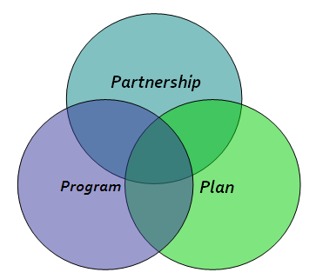
Comprehensive Cancer Control in Wisconsin
WI Cancer Council
Coalition of organizations dedicated to the development, implementation and evaluation of the WI CCC Plan.
WI CCC Program
The state's cancer prevention and control program that facilitates the development, implementation and evaluation of the WI CCC Plan.
WI CCC Plan 2015-2020
Serves as a common framework for action for all working on cancer prevention and control in Wisconsin.
Notes:
In Wisconsin, we think of Comprehensive Cancer Control then as 3 components, each having its own role but overlapping to make up one movement.
The Plan: is the WI CCC Plan 2015-2020. It serves as the common framework for action for all partners in WI working on cancer prevention and control
The Program: is the WI CCC Program – the state’s cancer prevention and control program that facilitates the development, implementation and evaluation of the WI CCC Plan
Our partnership here in WI is the WI Cancer Council. It is the Coalition of organizations dedicated to the development, implementation and evaluation of the WI CCC Plan.

Slide 7
WI Comprehensive Cancer Control PLAN
Common framework for action in cancer prevention and control
Designed to provide a vision of what needs to be done and the resources needed to reduce the burden of cancer in Wisconsin.

Slide 9
WI CCC Plan – Cross Cutting Issues
Notes:
Cross cutting issues do not have a separate goal but are instead threaded throughout each priority to ensure that strategies and action steps include these important elements.

Slide 10
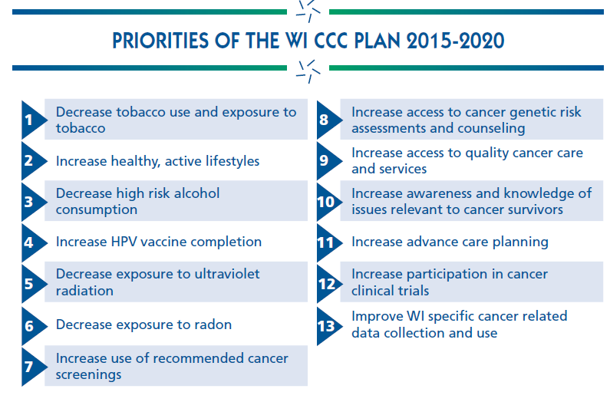
WI CCC Plan Priorities

Slide 11
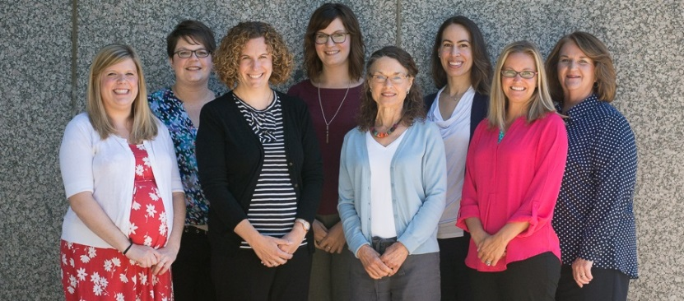
WI Comprehensive Cancer Control PROGRAM
The state's cancer prevention and control program
Coordinates the development of the WI CCC Plan.
Promotes the implementation of the WI CCC Plan.
Facilitator of and staffing for the Wisconsin Cancer Council.
11
Notes:
As a member of the Wisconsin Cancer Council, the WI CCC Program shares in the implementation and promotion of the WI CCC Plan with its fellow Wisconsin Cancer Council members

Slide 12
Wisconsin Cancer COUNCIL
Engages diverse partners to develop, implement and promote a statewide comprehensive approach to cancer control.
Established in late 1980s
Partners ready to come together to develop the WI CCC Plan in 2003-2005.
Developed and implementing WI CCC Plan for the last 10+ years.

Slide 13
WI Cancer Council Growth

Slide 14
After the release of WI CCC Plan 2015-2020
Rapid Growth over 10 years
WI Cancer Council Member engagement was declining
It was time to better engage diverse partners
to implement and promote
a statewide comprehensive approach to cancer control.
Notes:
It has been 10 years and 2 5-year CCC plans since the WI Cancer Council itself has been reviewed to make sure it is effectively engaging partners to develop, implement, and promote a statewide comprehensive approach to cancer control.
Now with the recent release of Wisconsin’s 3rd edition of the WI CCC Plan, the time was right to review the Council & its structure to better engage diverse partners to implement and promote a statewide comprehensive approach to cancer control.

Slide 15
Objectives of WCC Revitalization
WCC Member Re-Engagement
Improve the benefits offered to WCC members for Plan Implementation
Enhance the WI Cancer Council structure to help with member engagement and creating benefits for WI CCC Plan Implementation.
Notes:
So in 2016, we recruited a Leadership Team of 15 partners to come together and re-look at the WI Cancer Council to make it strong and most effective for the next decade.
The Leadership Team was tasked with the follow 3 items:
1. Revitalize the processes for member engagement – both for previous members and new members to the WI Cancer Council. 2. Developed new and improved benefits that will be offered to WCC members to help them with WI CCC Plan implementation. 3. And finally, we are working on an enhanced structure that will support member engagement and offer members benefits so that they can better implement cancer control in Wisconsin.

Slide 16
1. Member Re-Engagement
Ask all organizations to re-commit to the WI Cancer Council
Improved member organization and individual member applications
Clarify the benefits to members
Offer opportunities to learn about the WCC & meet other members in your own region
Notes:
First “Objective of Revitalization – Member Re-engagement”

Slide 17
WISCONSIN CANCER COUNCIL
A coalition of organizations dedicated to
reducing the burden of cancer in Wisconsin.
MEMBER ORGANIZATION
Statewide, regional and local organizations or programs with all or some its mission dedicated to reducing the burden of cancer in Wisconsin.
MEMBER REPRESENTATIVES
Individuals/Employees that work within a MEMBER ORGANIZATION and utilize the benefits of their organization’s membership to implement the WI Comprehensive Cancer Control (CCC) Plan.
LEAD MEMBER REPRESENTATIVE
A MEMBER REPRESENTATIVE that also serves as the main point of contact between the WI Cancer Council and the MEMBER ORGANIZATION they represent.
Notes:
The WI Cancer Council is a coalition of organizations – our strength is in the organizations coming together. Within those organizations though we need member representatives who will work to implement the WI CCC Plan through the work that they do.
With Member re-engagement, we are working to re-engage the organization as well as individuals that work for those organizations.
We now have a way to better capture the member organization information as well as information on individual member representatives. This will be through our Member Commitment forms – which we will talk about in the Tangible Tools presentation. There is no cost or limit to the # of members.

Slide 18
2. Improve Member Benefits
More on this later today…
“Tools for Cancer Control Success”
Tangible Resources for
WI Cancer Council Members
Notes:
Second “Objective of Revitalization – Improved Member Benefits”

Slide 19
3. Enhance WCC Structure
Leadership Team is still developing this in late 2016.
What will the future WCC leadership body (Steering Committee) be?
What committees does the WCC need?
What are the priority areas of the WI CCC Plan that the WI Cancer Council will work on together?
Unveiled at 2017 Annual Meeting – May 11, 2017.
Notes:
Third “Objective of Revitalization – Enhance WCC Structure”
This is still in process – the Leadership Team is developing and finalizing through 2016.

Slide 20
In 2017, what will success look like?
Member
re-engagement
Engaged diverse partners ready
to implement and promote a statewide comprehensive approach to cancer control!
By 2017, the Wisconsin Cancer Council will have
Improved benefits for WI CCC Plan Implementation
Enhanced WI Cancer Council Structure
Notes:
So, in 2017, we believe this is what success will look like:
Member re-engagement work and improved benefits will lead to a 2017 WI Cancer Council with engaged diverse partners ready to implement and promote a statewide, comprehensive approach to cancer control.
This success will be supported, maintained and monitored with the enhanced WI Cancer Council structure

Slide 21
Questions?
Amy Conlon, MPH
WI CCC Program Director
ajconlon@uwcarbone.wisc.edu
608-265-9322
Milwaukee Madison De Pere Eau Claire La Crosse

